Slide 1
MACHINE LEARNING
AGENDA
UNSUPERVISED LEARNING
CLUSTERING
TYPES OF CLUSTERING
K-Means Clustering
Bisecting K-means Clustering
Agglomerative Clustering
Spectral Clustering
DBSCAN Clustering
Optics Clustering
HDBSCAN Clustering
Means Shift Clustering
Affinity Propagation Clustering
BIRCH_Clustering

Slide 2
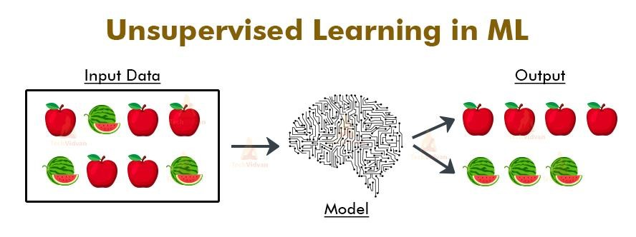
UNSUPERVISED LEARNING
The given data is not labeled (ie) the outcome of the dataset will not be provided.

Slide 3
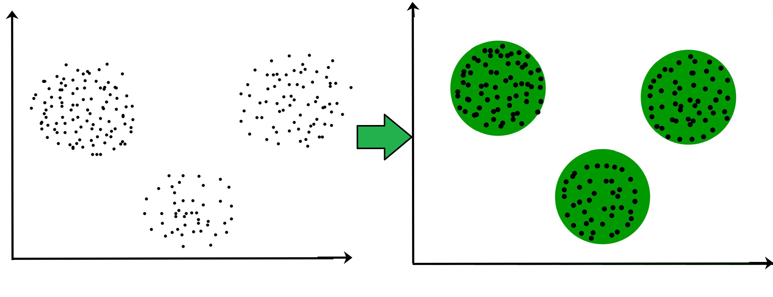
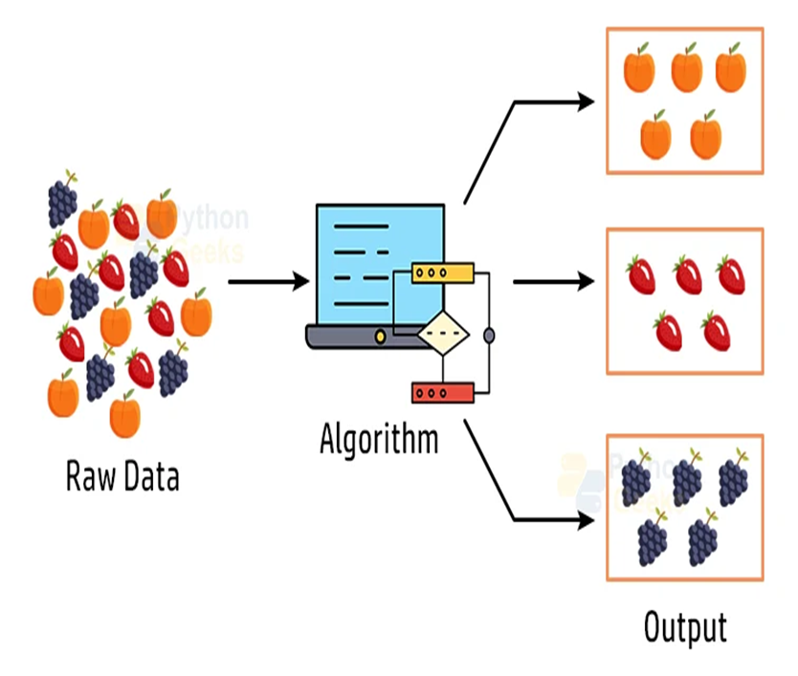
CLUSTERING The task of grouping data points based on their similarity with each other .

Slide 4
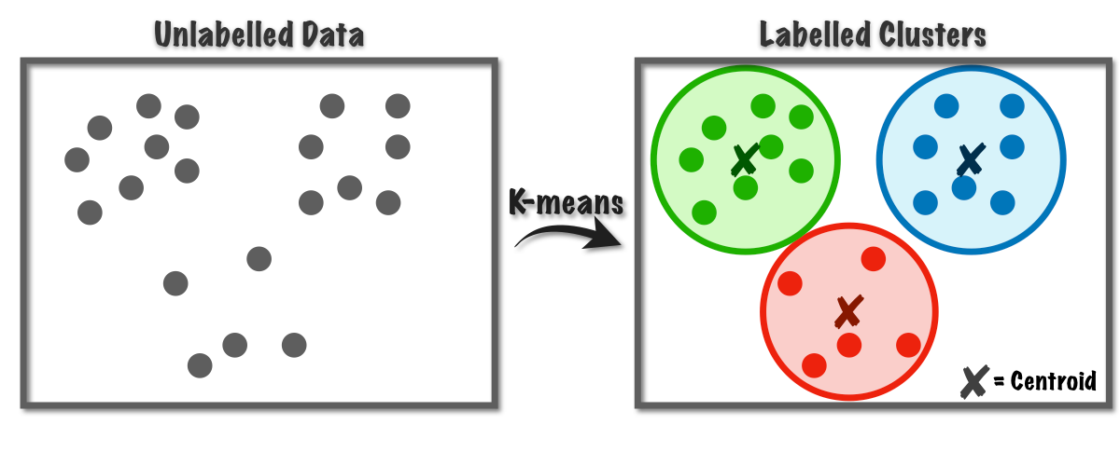
K-MEANS CLUSTERING K=No of Clusters Means=Average of x and y coordinates
Select an appropriate value for K which is the number of clusters or centroids
Select random centroids for each cluster
Assign each data point to its closest centroids
Adjust the centroid for newly formed cluster by finding the mean of the x and y coordinates of each point in the cluster.
Repeat step 4 and 5 until all the data point are perfectly organized within the cluster space

Slide 5
Advantages:
Easy to understand and implement.
Efficient, Robust, and Flexible
If data sets are distinct and spherical clusters, then give the best results
Disadvantages:
This algorithm needs prior specification for the number of cluster centers that is the value of K.
It cannot handle outliers and noisy data, as the centroids get deflected
It does not work well with a very large set of datasets as it takes huge computational time.

Slide 6
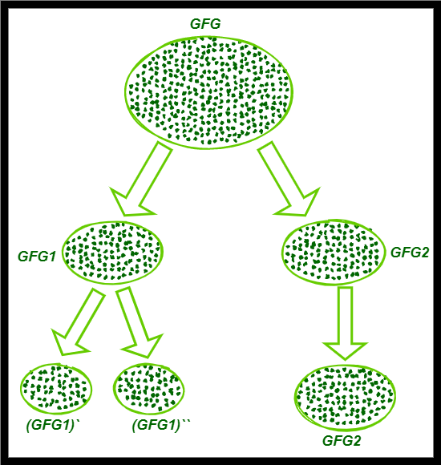
BISECTING K-MEANS CLUSTERING (Hybrid of Partitional and Hierarchial clustering)
Apply K-Means
(K=3 ie at the final stage number of clusters should be 3)
All points/objects/instances are put into 1 cluster.
Initially the cluster is split into two. The required number of clusters are not obtained.
The SSE(Sum of squared error) will be calculated for the clusters.
SSE=(C_{X} - X _{i} ) ²+ (C_{y} - Y _{i} ) ²
The cluster with high SSE will be split further.
Step 3 and 4 will get repeated until the required number of clusters are obtained at the final stage

Slide 7
Advantages:
It beats K-Means in entropy measurement
When K is big, bisecting k-means is more effective
k-means is known yield clusters of varied sizes, bisecting k-means results in clusters of comparable sizes.
Disadvantages:
This algorithm needs prior specification for the number of cluster centers that is the value of K.
Time Consuming

Slide 8
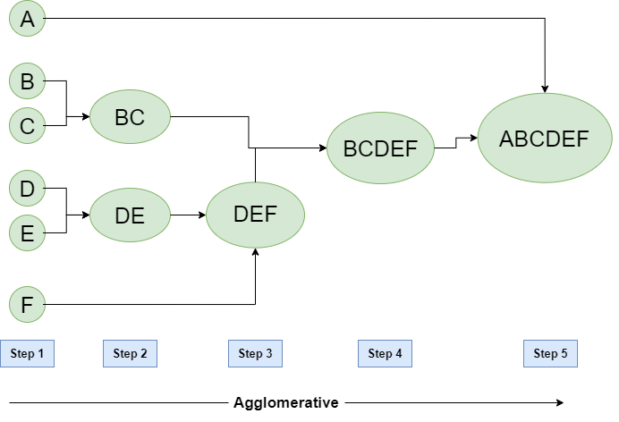
AGGLOMERATIVE CLUSTERING ( Bottom-up approach or hierarchical agglomerative clustering (HAC))
Compute the proximity matrix using a distance metric.
Use a linkage function to group objects into a hierarchical cluster tree based on the computed distance matrix from the above step.
Data points with close proximity are merged together to form a cluster.
Repeat steps 2 and 3 until a single cluster remains.

Slide 9
Advantages
No need for information about how many numbers of clusters are required.
Easy to use and implement
Disadvantages
We can not take a step back in this algorithm.
Time complexity is higher at least 0(n^2logn)

Slide 10
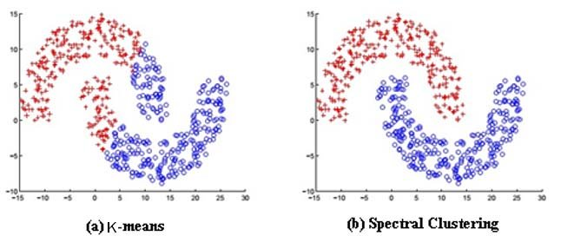
SPECTRAL CLUSTERING (Groups data based on similarity)
Spectral Clustering is a variant of the clustering algorithm that uses the connectivity between the data points to form the clustering.
Construct similarity graph and compute its affinity matrix
Projecting the data onto a lower dimensional space. It is done by computing Graph Laplacian matrix L=D-A
Compute the first k eigen vectors corresponding to the lowest eigenvalues of Lr and form the matrix U containing these vectors as columns
Let yi be the vectors corresponding to the ith row of U
Cluster yi with k-means algorithm into k clusters

Slide 11
Advantages
Flexibility: Can handle any type of data distribution and shape
Less sensitive to noise
Easy to implement
Disadvantages
Computationally expensive
Complex concept

Slide 12
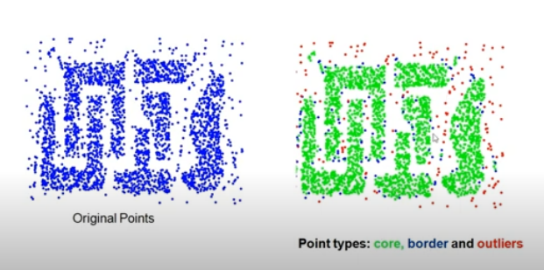
DBSCAN CLUSTERING (DBSCAN stands for Density-Based Spatial Clustering Application with Noise)
It is an unsupervised machine learning algorithm that makes clusters based upon the density of the data points or how close the data is.
Choose a value for eps and MinPts
For a particular data point (x) calculate its distance from every other datapoint
Find all the neighbourhood points of x which fall inside the circle of radius (eps) or simply whose distance from x <= eps
Treat x as visited and if the number of neighbourhood points around x >= to MinPts then treat x as a core point and if it is not assigned to any cluster, create a new cluster and assign it to that.
If the number of neighbourhood points around x < MinPts and it has a core point in its neighbourhood, treat it as a border point
Include all the density connected points as a single cluster
Repeat the above steps for every unvisited point in the data set and find out all core, border and outlier points

Slide 13
Advantages
Very intuitive and easy to understand. It is based on the concept of density, which is a very natural way to classify objects.
Can classify points as outliers, which is very important in real-world datasets.
Works great on data that is arbitrarily shaped.
Disadvantages
Very sensitive to its parameters ε and minPts.
Not very efficient when working with high-dimensional data.
The classification of border points may be non-consistent.

Slide 14
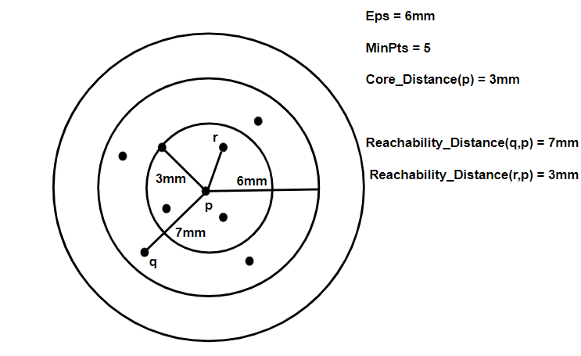
OPTICS CLUSTERING (Ordering Points to Identify the Clustering Structure)
Algorithm for density clusters in spatial data, It can handle data of varying densities.
Main Parameters
Core Points & Min Pts
Core Distance
Reachability distance
The OPTICS algorithm follows these main steps
Define a density threshold parameter, Eps, which controls the minimum density of clusters
Starting with an arbitrary point, calculate the reachability distance of each point in the dataset, based on the density of its neighbors. Order the points based on their reachability distance and create the reachability plot.
Extract clusters from the reachability plot by grouping points that are close to each other and have similar reachability distances.

Slide 15
Advantages
OPTICS clustering doesn’t require a predefined number of clusters in advance.
Clusters can be of any shape, including non-spherical ones.
Able to identify outliers(noise data)
Disadvantages
It fails if there are no density drops between clusters.
It is also sensitive to parameters that define density( radius and the minimum number of points) and proper parameter settings require domain knowledge.

Slide 16
HDBSCAN CLUSTERING (Dynamically adjust to the different densities and forms of clusters in the data)
It is designed to uncover clusters in datasets based on the density distribution of data
It uses high-density regions to identify clusters and views isolated or low-density points as noise
Algorithm:
. It starts by calculating a density-based clustering hierarchy, which creates clusters from densely connected data points.
The algorithm then extracts clusters from the hierarchy, taking into the account the stability of cluster assignments across different levels of the hierarchy.
It identifies stable clusters as those with consistent memberships at multiple levels, ensuring cluster formation robustness.
Include all the density connected points as a single cluster
HDBSCAN captures and eliminates the noise by constantly adjusting the minimum cluster size parameter and adding a minimum spanning tree.

Slide 17
Advantages
Automatic cluster Discovery
Handling Cluster Shapes
Hierarchical Clustering
Disadvantages
Computationally Intensive
Sensitive to Distance metric
Parameter Sensitivity

Slide 18
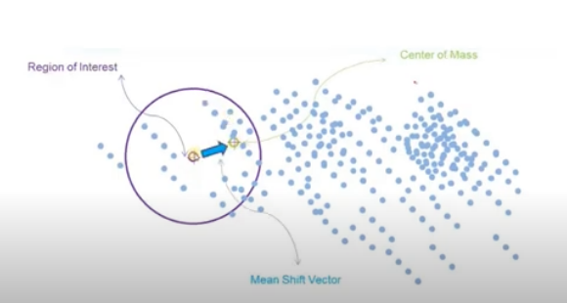
Mean-Shift CLUSTERING (Mean-shift clustering is a non-parametric, density-based clustering algorithm that can be used to identify clusters in a dataset)
The Mean-Shift clustering algorithm is a non-parametric clustering algorithm that works by iteratively shifting the mean of a data point towards the densest area of the data.
Algorithm:
Initialize the data points as cluster centroids
For each data point, compute the mean shift vector, which is the vector that points towards the densest area of the data.
Update the mean of each data point by shifting it towards the densest area of the data.
Repeat steps 2 and 3 until convergence is reached.

Slide 19
Advantages
It can handle arbitrary data shapes and sizes.
It doesn’t require prior knowledge of the number of clusters.
It doesn’t make assumptions about the distribution of data points.
It can work well with noisy data.
Disadvantages
It is computationally expensive, especially for large datasets.
It is sensitive to the choice of bandwidth, which affects the cluster sizes and shapes.
It may converge to local optima instead of the global optimum.

Slide 20
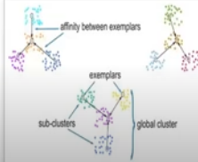
AFFINITY PROPAGATION CLUSTERING
Affinity Propagation is based on the concept of “message-passing” between data points to identify cluster centres and assign data points to these centres automatically.
It utilizes “exemplars,” which are typical data points representing other data points within the same cluster.
The idea behind Affinity Propagation is to iteratively update two matrices:
The responsibility matrix and the availability matrix.
The responsibility matrix contains information about how well-suited each data point is to serve as an exemplar for another data point.
The availability matrix contains information about how much each data point wants to select another data point as an exemplar.
The algorithm alternates between updating these two matrices until convergence is achieved.
The final exemplars are chosen based on the maximum values in the responsibility matrix.

Slide 21
Advantages
Affinity Propagation can identify the number of clusters automatically without specifying the number of clusters in advance.
It can handle clusters of arbitrary shapes and sizes.
It can handle datasets with noisy or incomplete data.
It is relatively insensitive to the choice of initial parameters.
It has been shown to outperform other clustering algorithms on certain types of datasets.
Disadvantages
It can be computationally expensive for large datasets or datasets with many features.
It may converge to suboptimal solutions, especially when the data has a high degree of variability or noise.
It can be sensitive to the choice of the damping factor, which controls the rate of convergence.
It may produce many small clusters or clusters with only one or a few members, which may not be meaningful.
It can be difficult to interpret the resulting clusters, as the algorithm does not provide explicit information about the meaning or characteristics of the clusters.

Slide 22
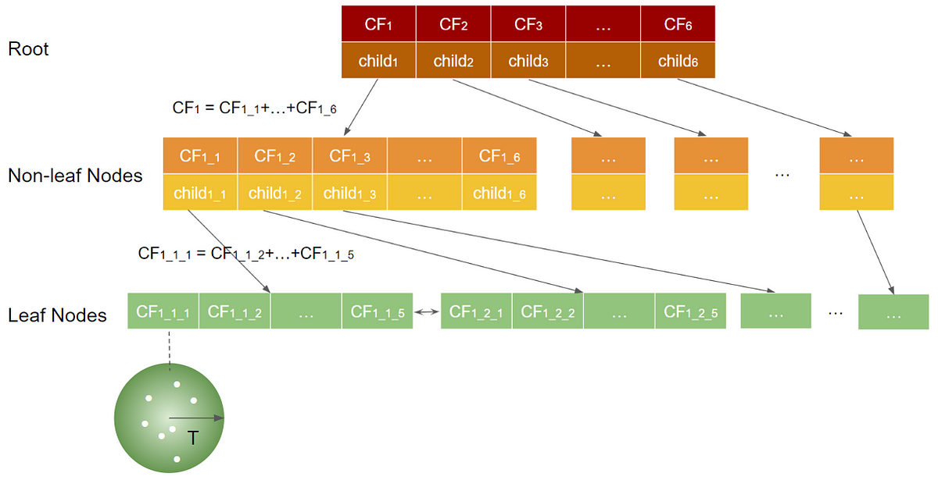
BIRCH CLUSTERING
Balanced Iterative Reducing and Clustering using Hierarchies (BIRCH)
Clustering algorithm that can cluster large datasets by first generating a small and compact summary of the large dataset that retains as much information as possible
This smaller summary is then clustered instead of clustering the larger dataset
BIRCH summarizes large datasets into smaller, dense regions called Clustering Feature (CF) entries.
Formally, a Clustering Feature entry is defined as an ordered triple, (N, LS, SS) where ‘N’ is the number of data points in the cluster, ‘LS’ is the linear sum of the data points and ‘SS’ is the squared sum of the data points in the cluster
It is possible for a CF entry to be composed of other CF entries
A CF tree is a tree where each leaf node contains a sub-cluster. Every entry in a CF tree contains a pointer to a child node and a CF entry made up of the sum of CF entries in the child nodes. There is a maximum number of entries in each leaf node. This maximum number is called the threshold

Slide 23
Advantages
Scalability − BIRCH is designed to handle large datasets efficiently by using a treelike structure to represent the clusters.
Memory efficiency − BIRCH uses CF and SCF data structures to summarize the statistical properties of the data points, which reduces the memory required to store the clusters.
Fast clustering − BIRCH can cluster the data points quickly because it uses an incremental clustering approach.
Disadvantages
Sensitivity to parameter settings − The performance of BIRCH clustering can be sensitive to the choice of parameters, such as the maximum number of CFs that can be stored in a node and the threshold value used to create subclusters.
Limited ability to handle non-spherical clusters − BIRCH assumes that the clusters are spherical, which means it may not perform well on datasets with nonspherical clusters.
Limited flexibility in the choice of distance metric − BIRCH uses the Euclidean distance metric by default, which may not be appropriate for all datasets.

